Slide 1
Frontend Development AngularJS
Pregatit de: Alexandru Dima Data: 20.10.2014

Slide 2
Topics - Introduction - Directives - Create an application - Controllers - Scopes - HTTP Requests
Pregatit de: Alexandru Dima Data: 20.10.2014

Slide 3
Introduction
MVW Framework
Written in JavaScript
Two Way Binding
Extends HTML vocabulary
Compile templates
Scope
Dependency Injection

Slide 4
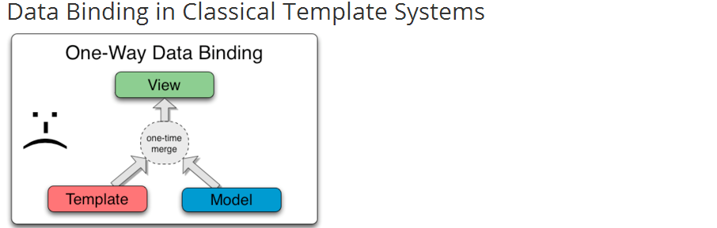
Introduction

Slide 5
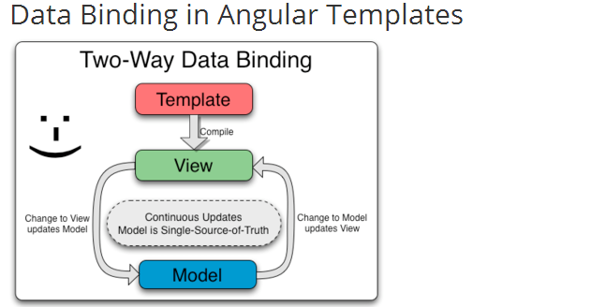
Introduction

Slide 6
Application
An application is build from modules;
Module:
A container for parts of the application;
Easy to understand;
Can be used as reusable components;

Slide 7
Application
Initializes the built-in objects;
Creates the AngularJS scopes;
Starts the compiler;

Slide 8
Application
To initialize an AngularJS application:
angular.module(‘appName', []);
<ANY ng-app=“appName”…>…</ANY>

Slide 9
Application
AngularJS built-in objects:
angular
$routeProvider
$http
$rootScope
$scope
…

Slide 10
Workshop: AngularJS Application

Slide 11
Scope
Object that represents the model
Nested structure
$rootScope – main scope
Other scopes ar childs of $rootScope or other child scopes

Slide 12
Directives
Extend angular vocabulary
Markers on DOM elements
Types:
HTML attributes
HTML elements
CSS classes
HTML comments
Add specific behavior
Transform and manipulate DOM

Slide 13
Directives
ng-app: initialize an AngularJS application
ng-view: main template
ng-include: include HTML templates
ng-show/ng-hide: show/hide elements
ng-click: triggers on user click and executes an expression
ng-model: binds a model variable to an element
ng-repeat: loops an Array or Object
ng-controller: binds a controller to the current element

Slide 14
Routes
Have multiple templates by routing(simulate multiple pages);
Part of URL(ex: ‘#/myroute’);
Configure what template to show and what controller to use for manipulating the model;

Slide 15
Controllers
Functions
Control interaction with templates
Add behavior
Declaration:
myApp.controller(‘MyController‘, [‘dependency’, function(dependency) { … }])
myApp.controller(‘MyController‘, function(dependency) { … })
Use:
ng-controller=“MyController”
Inside $routeProvider

Slide 16
Workshop: AngularJS Bindings & Scopes

Slide 17
HTTP Requests
Send AJAX requests to a server
Asynchronous
Success and error callback functions
Data as JSON Objects

Slide 18
HTTP Requests
$http({url: 'http://demo.teamnet.ro:8282/datamodel/departments/findAll', method: 'GET‘, data: {}, params: {}).
success(function(data, status, headers, config) {
}).
error(function(data, status, headers, config) {
});

Slide 19
HTTP Requests
JSON: key/value structure;
Ex:
{
“key1”: “value1”,
“key2”: 1,
“key3”: [1,2],
“key4: {“key5”: “value5”}
}

Slide 20
Workshop: AngularJS HTTP request

Slide 21
Questions?

Slide 22
Thank you!

